Slide 1
Field Test Report
E1180 Vehicle mounted Battery Charger Test Report
Report by:
Kibet Rotich

Slide 2
Test Introduction
Installation
Test Results
Conclusion
Recommendations

Slide 3
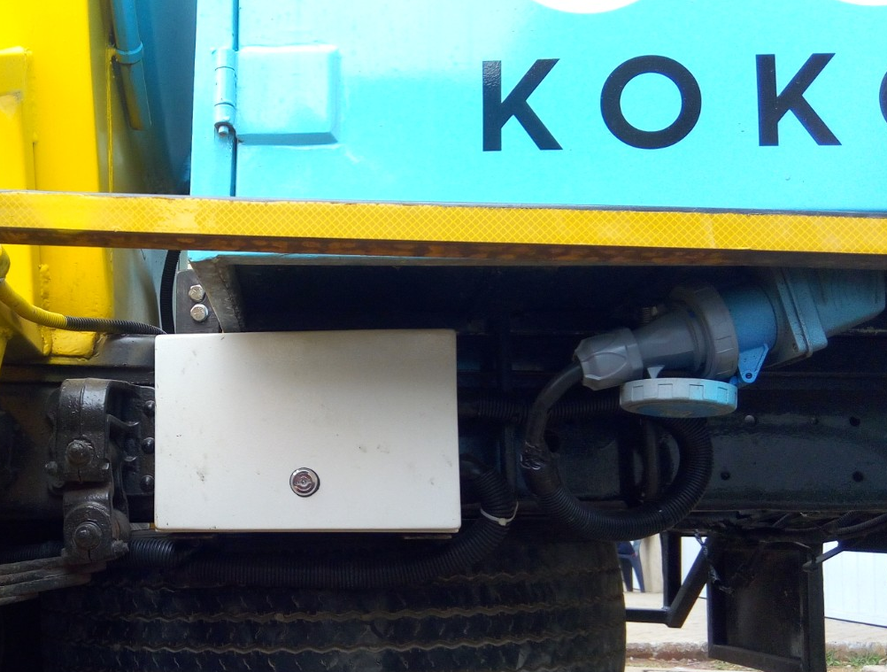
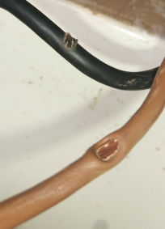
Introduction
Objective
To assess the suitability of E1180 battery charger to improve vehicle-charging capability of STS.
Install E1180 battery charger and assess performance.
To reduce short circuit incidences attributed to deterioration of cable insulation.
Use battery grade cables to reduce short circuit risks.
Assess the suitability of using resettable breakers in place of fuses.
Background
Currently STS v6.1 has a vehicle mounted E1176 battery charger installed, which draws energy from the truck alternator and is used to supplement STS battery charging from mains. Micro-tanker batteries are charged via mains overnight when the truck is parked.
When the operator fails to put the truck on mains charging overnight, the STS battery runs out during daily KP refills prompting the operator to leave the truck engine running when refilling KPs.
There is need to improve STS battery charging capacity via the truck alternator so that there is improved reliability on vehicle-mounted charger for emergency charging as is defined in STS v6.2 working specification 7b.
There is need for a robust vibration proof cabling as defined in STS v6.2 working specification 7e.

Slide 4
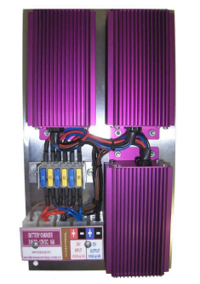
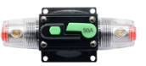
Test & Expected Outcomes
Test
Mount E1180 battery charger in a micro-tanker and assess STS power requirements for a period of 4 weeks. During this period, the STS shall solely rely on the vehicle-mounted charger for effective results.
Mount resettable fuses and monitor performance for a period of 4 weeks.
Install battery grade cabling and inspect for integrity after 4 weeks.
Expected outcomes
Based on initial evaluations (STS charging design improvement), the micro tanker should complete at least 17 daily refills of approx 250 litres delivered per day when using vehicle-mounted charger.
There should be no weakening of charging cables insulation due to vibration or inherent heat dissipation by the cables.
Reduced cases of fuse blowing.

Slide 5
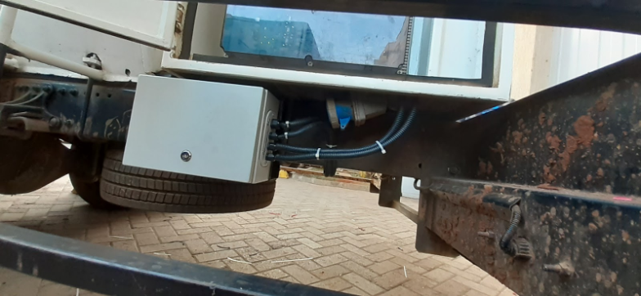
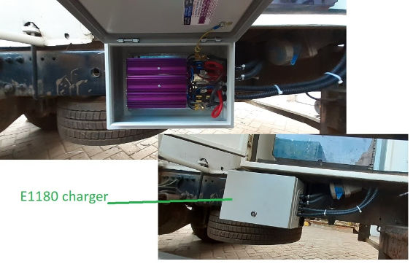
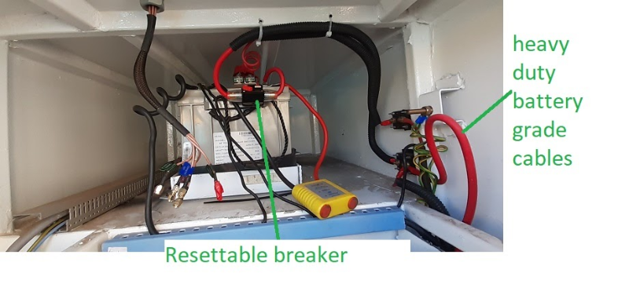
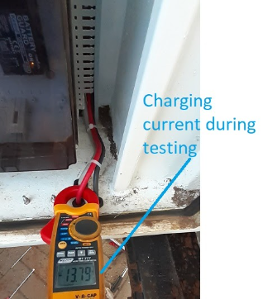
Installation
E1180 vehicle mounted charger
Mounted on the truck chassis beneath the STS.
Mounting bracket to be fabricated depending on truck chassis dimensions.
Cabling directly routed to STS battery via isolator switches. (Refer to wiring schematic).
Resettable breakers
60A circuit breaker connected to the charging circuit at the 12V STS battery termination.
50A circuit breaker connected to the charging circuit at the 24V truck battery termination.
Robust cables
Separate -ve and +ve wiring made for the charging circuit using battery grade cables.
Routing path via STS ‘roof’ introduced.

Slide 6
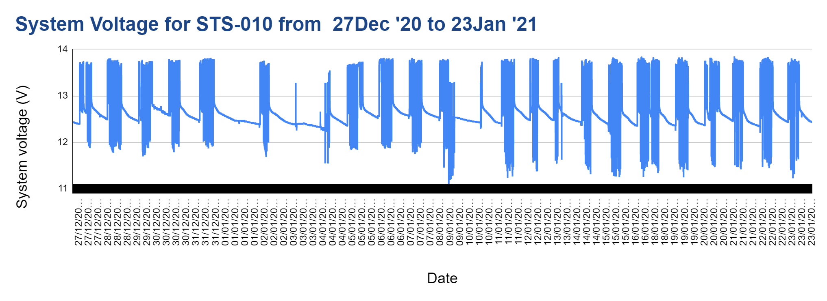
Test Results
System voltage trend on a daily basis was plotted for the last 4 weeks since installation to date.
In the entire testing duration since installation, the STS relied on the vehicle-mounted battery charger and the system voltage remained above 12.25(battery low threshold). Batter remained well above 12.7 at the end of all daily refills.

Slide 7
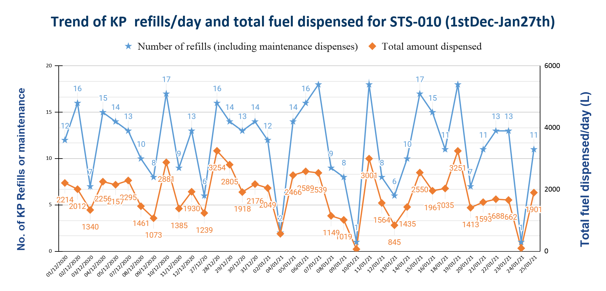
Test Results
The number of refills made per day was tracked for 21 refill days since installation to date.
Link to source data
The amount of fuel delivered/day increased slightly from between (1400-2000) to between 1400-3250). Number of KP deliveries made peaked at 17. This illustrates that the charger meets the design requirements of >17 refills per day.
Charger installation date

Slide 8
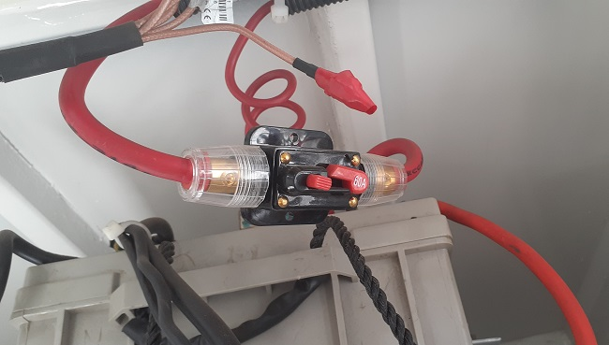
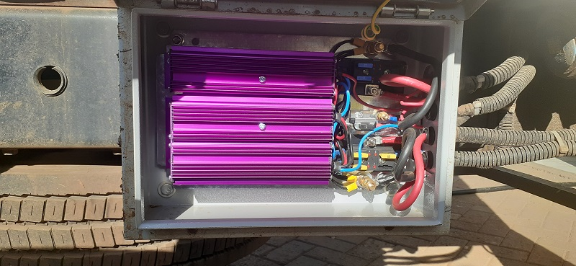
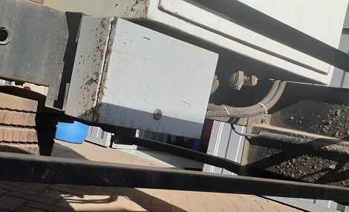
Test Results
Resettable breakers
The only issue reported during this period was #INC-37309 attributed to a short circuit on the mains charging port(unrelated to the charger under test). The mains line was isolated and no other issue was observed or reported.
Whenever the truck is refilling a KP when the engine is running, the circuit breaker keeps tripping intermittently attributed to an overload(truck charger supplies power to both pump and STS battery hence the breaker becomes overcurrented).
This was resolved by instructing the operator to keep the truck engine off whenever refilling KPs as is the norm.
Robust cables
There was no issue reported or observed on cable looseness or insulation wear. This illustrates that the cabling used were of good quality.

Slide 9
Conclusions
E1180 battery charger:
The charger proved to be reliable and of sufficient capacity to handle over 17 KP refills and greater than 3250 Litres of fuel delivered per day per STS, even in situations where mains charging is unavailable.
Robust cables:
Battery grade cables were determined to meet the insulation robustness required for STS operating environments since no deterioration or looseness were observed.
Resettable breakers:
The auto circuit breaker model tested were found to be reliable in reducing the number of fuse blowing issues and lowering the cost associated with frequent fuse replacements.

Slide 10
Recommendations
Adopt E1180 charger for future micro takers(STS v6.2) with alternator size >90A and whose expected KP refill operations results in a short distance travelled between KPs.
FYI: The short distance travelled between KPs results in less cumulative engine running time.
Adopt the use of battery grade cables for STS v6.2 power cables.
FYI: The cables shall be sized accordingly based on expected current capacity.
Adopt the use of resettable circuit breakers for efficient detection of STS current overloads and short circuits.
FYI: The resettable breakers shall be sized accordingly depending on the area of application.
Appendix
STS 010 system voltage from 26th Dec 2020 to Jan 2021
fuel_transaction_history STS-010
E1180 Charger: BOM, Installation & Monitoring plan
E1180 Battery charger wiring

Slide 11
THANK YOU!
k.rotich@kokonetworks.com

